Slide 1

Ms in Data Science
EXPLORING AND ANALYZING DATA Final Project
Submitted to Deree – The American College of Greece
Submitted by Kapsalis C. , Alimpertis D., Zouras I., Μargaritis K.

Slide 2
Dataset Selection
The COVID-19 pandemic significantly impacted every aspect of people’s everyday lives all over the globe.
The policy decisions that guided the imposition of measures such as lockdowns, which dictated our lifestyle for prolonged time periods, were made based on data regarding the progress of positive cases and deaths in time.
These data were closely monitored by national agencies and are readily available online.
Thus, we found it very special to apply the methods we were tought on a dataset concerning information that affected us in such a drastic manner.

Slide 3
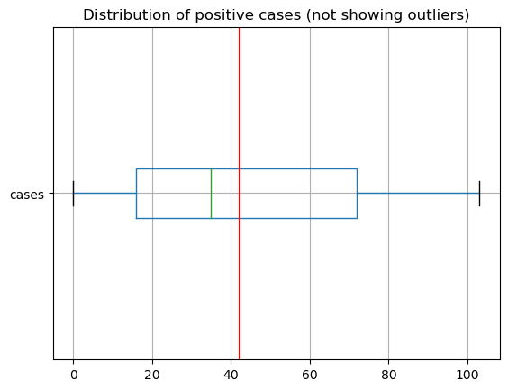
Dataset Features and Processing
28,715 observations concerning the count of COVID-19 cases and related deaths in 30 EU/EEA countries.
As our main forecast variable, we selected the count of cases in Greece.
Factors considered in cleaning the dataset:
Measurement Errors
we noticed some negative case values
Outliers
the Z-score method classified 7% of observations as outliers
The available data showed signs of asymmetry, so the validity of the Z-score method in ourlier detection in this case is questioned.

Slide 4
Data inconsistencies
Missing values showcasing mismatches in the chronological availability of data for each country
Selecting 10 relevant datasets and a specific the 2-year time interval – factors considered:
count of NaN values per country
Relative population sizes
Other sources of inconsistency ruled out
The resulting dataset contains 8,041 observations with daily frequency on the number of cases from Mar 1, 2020 to Mar 1, 2022 in Greece, Lithuania, Croatia, Ireland, Norway, Slovakia, Finland, Bulgaria, Hungary, Portugal, Czechia.
date | countriesAndTerritories | cases
2020-03-01 | Bulgaria | 4
2020-03-01 | Croatia | 2
2020-03-01 | Czechia | 3
2020-03-01 | Finland | 1
2020-03-01 | Greece | 2

Slide 5
Methods and Techniques
Forecasting techniques implemented:
Basis of selection: level of consideration of the time-series’ components
Naïve Approach
Simple Moving Average
Weighted Moving Average
Holt’s Method
Holt-Winter’s Method
A/F Ratios Method
Measures of comparison between forecasting methods:
Accuracy metrics:
Mean Absolute Deviation (MAD)
Mean Absolute Percentage Error (MAPE)
Bias metrics:
Tracking Signal

Slide 6
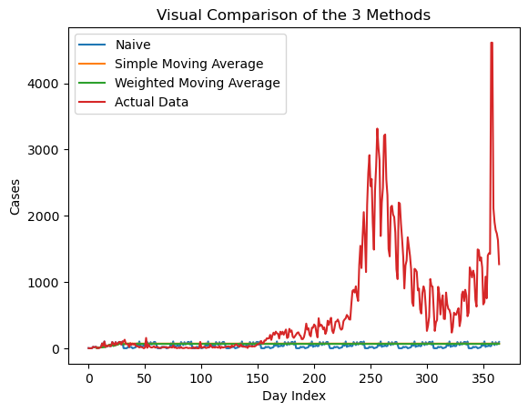
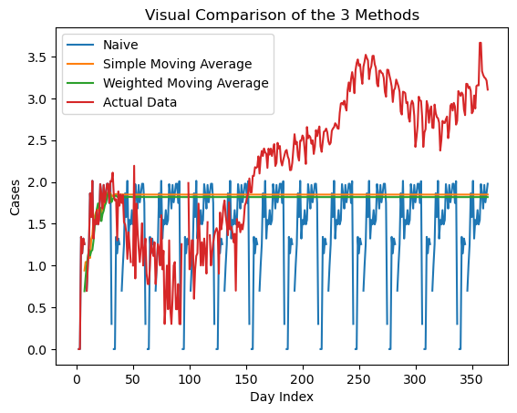
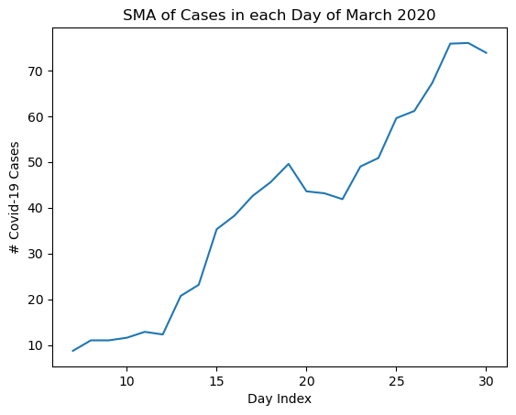
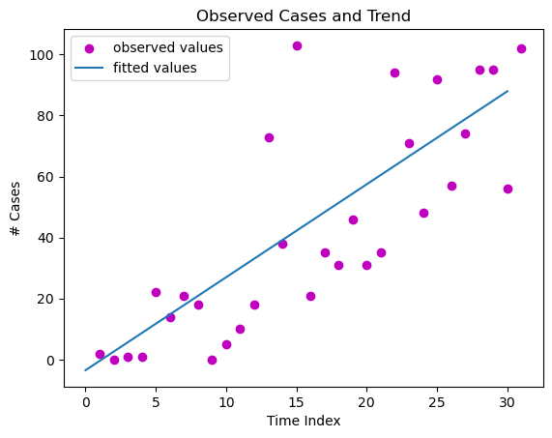
Results and Discussion – Year 1: Mar 2020, Mar 2021
Forecasting Method | MAD | Tracking Signal
Naive | 531.74 | 345.13
Simple Moving Average | 518.39 | 335.63
Weighted Moving Average | 519.99 | 337.75

Slide 7
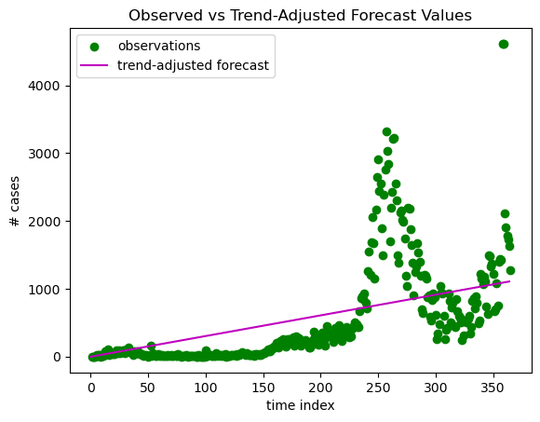
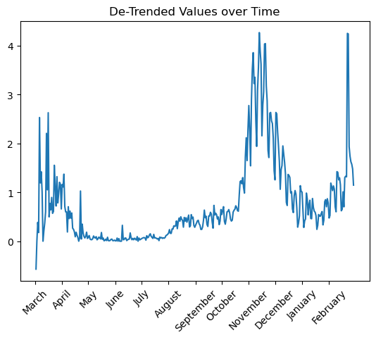
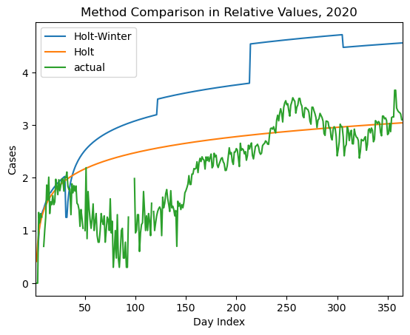
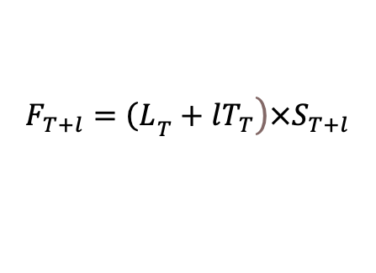
casesₜ = â + b̂ * time_index
 | Estimated Value | p-value for t-test
Intercept (a) | -6.548387 | 4.05E-01
Slope Coefficient (b) | 3.048387 | 6.13E-08
$$\left.F_{T+l}={\left(L\right.}_{T}+lT_{T}\right)×S_{T+l}$$

Slide 8
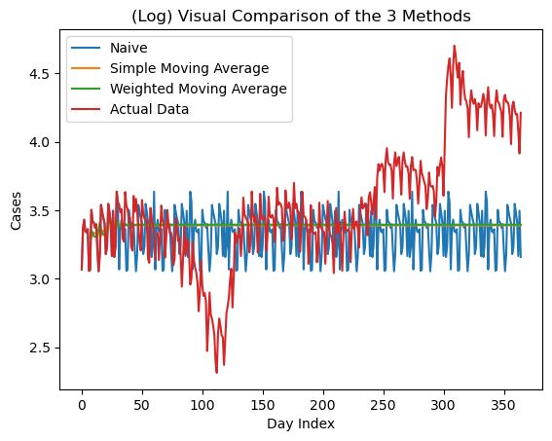
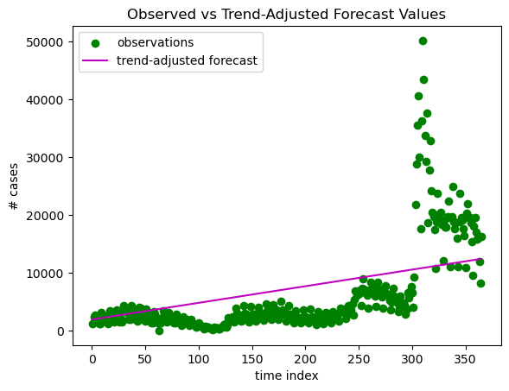
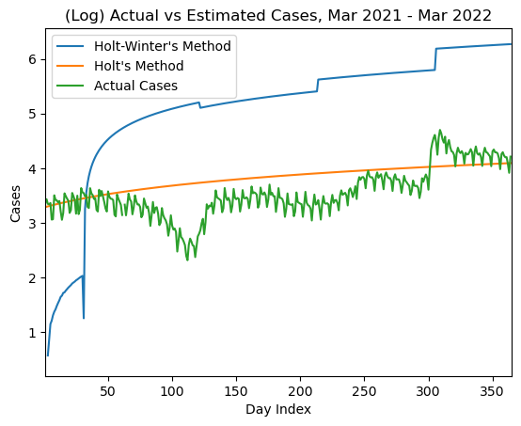
Results and Discussion – Year 2: Mar 2021, Mar 2022
The three simplest methods again gave us biased and heavily inaccurate results.
The same simple linear regression model used as before hinted at the existense of a trend.
The same seasonal cycles were assumed from inspecting the de-trended data, but forecasts proved extremely inaccurate.

Slide 9
Results and Discussion – Year 1 and 2 Comparison
Forecasting Method | MAD | Tracking Signal
Naive | 531.74 | 345.13
Simple Moving Average | 518.39 | 335.63
Weighted Moving Average | 519.99 | 337.75
Holt's Method | 401 | 886.62
Holt-Winter's Method | -17555 | 357.36
Forecasting Method | MAD | Tracking Signal
Naive | 3807.46 | 363.39
Simple Moving Average | 3694.45 | 363.34
Weighted Moving Average | 3668.85 | 363.32
Holt's Method | -1026 | 367.46
Holt-Winter's Method | -471474 | 364.12
Similarities:
Naïve, SMA, WMA: relatively similar in inaccuracy and bias, very high deviations
Holt’s method: the most accurate and also the most biased
Holt-Winter’s method: the most inaccurate
Differences:
MAD measures significantly higher in the second year
WMA’s bias less than SMA’s in second year’s results, in contrast to the first year

Slide 10
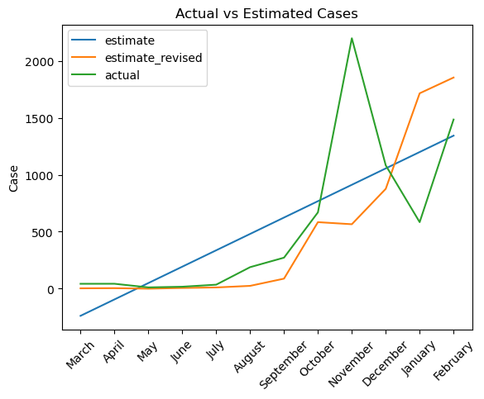
Comparative Analysis
We built a 12-point dataset using the mean count of positive cases in Greece and 10 more EU/EEA countries from March 2020 to March 2021.
To harness the information given by the data on all countries, we make use of A/F ratios.
Assumptions:
the progression of the virus did not differ much per country
the shared forecasting method was properly implemented
If the previous hold, we expect that this method would positively refine our results, because it considers a fuller image of the variance of phenomena similar to our main forecast variable.
Accuracy Metric | M.A.D. | M.A.P.E
Initial | 312.678 | 315.014
Final | 325.202 | 75.455

Slide 11
Conclusions and Future Work
Our forecasts heavily departed from the observed values in the period under study
The data we worked on were rather limited – just one month’s data were considered as ‘availaible’
The simple techniques implemented failed to grasp the intricacies of the phenomenon
The phenomenon itself was very unpredictable because its fundamentals continuously changed as it progressed into new phases

